Slide 1
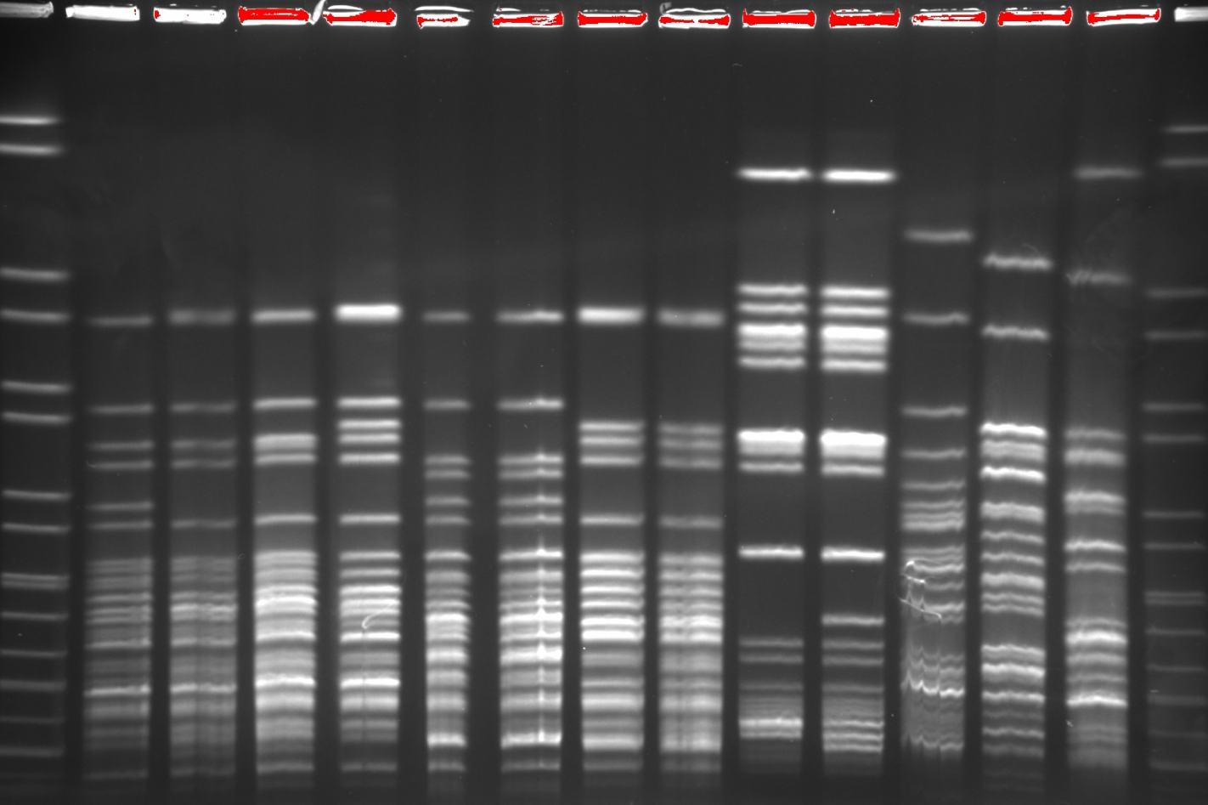
M
1
2
3
4
5
6
7
8
9
10
11
12
13
M
1135 kb
1135 kb
668.9 kb
668.9 kb
452.7 kb
452.7 kb
398.4 kb
398.4 kb
336.5 kb
336.5 kb
310.1 kb
310.1 kb
244.4 kb
244.4 kb
216.9 kb
216.9 kb
173.4 kb
173.4 kb
167.1 kb
167.1 kb
138.9 kb
138.9 kb
104.5 kb
104.5 kb
78.2 kb
78.2 kb
76.8 kb
76.8 kb
54.7 kb
54.7 kb
33.3 kb
33.3 kb
PFGE-type
C1
C1a
C1b
C1c
C1f
C1f
C1d
C1e
K1
K1a
E1
E2
E3
Figure S1: XbaI-restricted PFGE patterns of KPC-2-producing Enterobacteriaceae isolates from two German hospitals, 2016-2017. Lane M, Salmonella Braenderup H9812, XbaI-restricted; lane 1, 604-16 C. freundii bla_{KPC-2}, bla_{TEM-1}, bla_{OXA-1}, aac(6’)Ib-cr (patient #1); lane 2, 605-16 C. freundii bla_{KPC-2}, bla_{TEM-1}, bla_{OXA-1}, aac(6’)Ib-cr (patient #2); lane 3, 606-16 C. freundii bla_{KPC-2}, bla_{TEM-1}, bla_{OXA-1}, aac(6’)Ib-cr (patient #3); lane 4, 608-16 C. freundii bla_{KPC-2}, bla_{TEM-1}, bla_{OXA-1}, aac(6’)Ib-cr (patient #4); lane 5, 827-16 C. freundii bla_{KPC-2}, bla_{TEM-1}, bla_{OXA-1}, aac(6’)Ib-cr, qnrB2 (patient #7); lane 6, 828-16-1 C. freundii bla_{KPC-2}, bla_{TEM-1}, bla_{OXA-1}, aac(6’)Ib-cr, qnrB2 (patient #7); lane 7, 752-16 C. freundii bla_{KPC-2}, bla_{TEM-1}, bla_{OXA-1}, aac(6’)Ib-cr, qnrB2 (patient #5); lane 8, 611-16 C. freundii bla_{KPC-2}, bla_{TEM-1}, bla_{OXA-1}, aac(6’)Ib-cr, qnrB2 (patient #6); lane 9, 609-16 K. oytoca bla_{KPC-2}, bla_{TEM-1}, bla_{OXA-1}, aac(6’)Ib-cr, qnrB2 (patient #4); lane 10, 829-16 K. oytoca bla_{KPC-2}, bla_{TEM-1}, bla_{OXA-1}, aac(6’)Ib-cr, qnrB2 (patient #7); lane 11, 607-16 E. coli bla_{KPC-2}, bla_{TEM-1}, bla_{OXA-1}, aac(6’)Ib-cr, qnrB2 (patient #3), lane 12, 730-17 E. coli bla_{KPC-2}, bla_{TEM-1}, bla_{OXA-1}, aac(6’)Ib-cr (patient #2); lane 13, 731-17 E. coli bla_{KPC-2}, bla_{TEM-1}, bla_{OXA-1}, aac(6’)Ib-cr (patient #2).

Slide 2
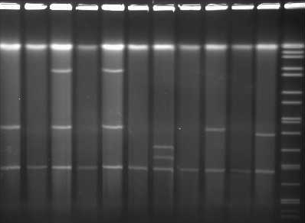
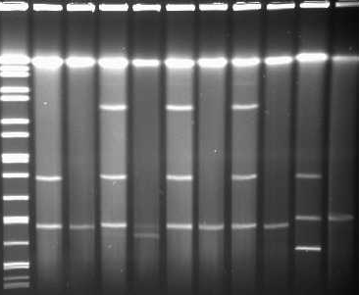
1
2
3
4
5
6
7
8
9
10
11
M
M
12
13
14
15
16
17
18
19
20
21
D
TC
D
TC
D
TC
D
TC
D
TC
D
D
TC
D
TC
D
TC
D
TC
D
TC
668.9 kb
452.7 kb
398.4 kb
336.5 kb
310.1 kb
244.4 kb
216.9 kb
173.4 kb
167.1 kb
138.9 kb
104.5 kb
78.2 kb
76.8 kb
54.7 kb
33.3 kb
28.8 kb
20.5 kb
Figure S2: Plasmid content obtained S1 nuclease restriction PFGE of selected KPC-2-producing clinical donor isolates (D) and transconjugants (TCs).
Lane M, Salmonella Braenderup H9812, XbaI-restricted; lane 1, 604-16 C. freundii bla_{KPC-2}, bla_{TEM-1}, bla_{OXA-1}, aac(6’)Ib-cr (patient #1); lane 2, 604-16K1 E. coli K12J53 bla_{KPC-2}, bla_{TEM-1}, bla_{OXA-1}, aac(6’)Ib-cr (patient #1); lane 3, 605-16 C. freundii bla_{KPC-2}, bla_{TEM-1}, bla_{OXA-1}, aac(6’)Ib-cr (patient #2); lane 4, 605-16K1 E. coli K12J53 bla_{KPC-2}, bla_{TEM-1}, bla_{OXA-1}, aac(6’)Ib-cr (patient #2); lane 5, 606-16 C. freundii bla_{KPC-2}, bla_{TEM-1}, bla_{OXA-1}, aac(6’)Ib-cr (patient #3); lane 6, 606-16K3 E. coli K12J53 bla_{KPC-2}, bla_{TEM-1}, bla_{OXA-1}, aac(6’)Ib-cr (patient #3); lane 7, 607-16 E. coli bla_{KPC-2}, bla_{TEM-1}, bla_{OXA-1}, aac(6’)Ib-cr, qnrB2 (patient #3); lane 8, 607-16K4 E. coli K12J53 bla_{KPC-2}, bla_{TEM-1}, bla_{OXA-1}, aac(6’)Ib-cr (patient #3); lane 9, 608-16 C. freundii bla_{KPC-2}, bla_{TEM-1}, bla_{OXA-1}, aac(6’)Ib-cr (patient #4); lane 10, 608-16K1 E. coli K12J53 bla_{KPC-2}, bla_{TEM-1}, bla_{OXA-1}, aac(6’)Ib-cr (patient #4); lane 11+12, 752-16 C. freundii bla_{KPC-2}, bla_{TEM-1}, bla_{OXA-1}, aac(6’)Ib-cr, qnrB2 (patient #5); lane 13, 752-16K2 E. coli K12J53 bla_{KPC-2}, bla_{TEM-1}, bla_{OXA-1}, aac(6’)Ib-cr, qnrB2 (patient #5); lane 14, 611-16 C. freundii bla_{KPC-2}, bla_{TEM-1}, bla_{OXA-1}, aac(6’)Ib-cr, qnrB2 (patient #6); lane 15, 611-16K1 E. coli K12J53 bla_{KPC-2}, bla_{TEM-1}, bla_{OXA-1}, aac(6’)Ib-cr, qnrB2 (patient #6); lane 16, 827-16 C. freundii bla_{KPC-2}, bla_{TEM-1}, bla_{OXA-1}, aac(6’)Ib-cr, qnrB2 (patient #7); lane 17, 827-16K3 E. coli K12J53 bla_{KPC-2}, bla_{TEM-1}, bla_{OXA-1}, aac(6’)Ib-cr, qnrB2 (patient #7), lane 18, 828-16-1 C. freundii bla_{KPC-2}, bla_{TEM-1}, bla_{OXA-1}, aac(6’)Ib-cr, qnrB2 (patient #7); lane 19, 828-16-1K2 E. coli K12J53 bla_{KPC-2}, bla_{TEM-1}, bla_{OXA-1}, aac(6’)Ib-cr, qnrB2 (patient #7); lane 20, 829-16 K. oxytoca bla_{KPC-2}, bla_{TEM-1}, bla_{OXA-1}, aac(6’)Ib-cr, qnrB2 (patient #7); lane 21, 829-16K4 E. coli K12J53 bla_{KPC-2}, bla_{TEM-1}, bla_{OXA-1}, aac(6’)Ib-cr, qnrB2 (patient #7); red arrows label the position of the bla_{KPC-2}-carrying plasmids.

Slide 3
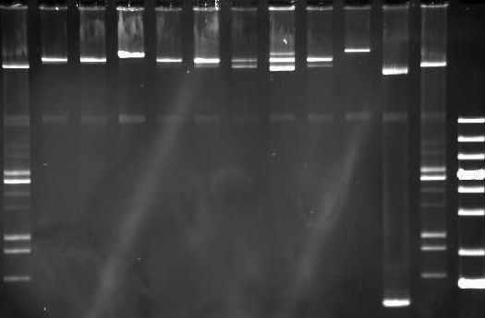
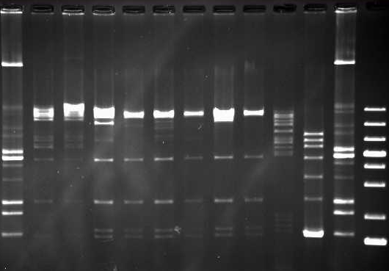
A)
Figure S3: Isolation and EcoR1 restriction of bla_{KPC-2}-carrying IncN plasmids from E. coli K12J53 transconjugants. A) native plasmid isolation (plasmid mini kit, Qiagen, Hilden, Germany); B) plasmid patterns restricted with EcoR1.
Lane M1, E. coli R222 + E. coli V517 plasmid standards; lane M2, molecular weight marker 1kb plus ladder (Thermo-Fisher Scientific); lane 1, 604-16K1 E. coli K12J53 bla_{KPC-2}, bla_{TEM-1}, bla_{OXA-1}, aac(6’)Ib-cr (patient #1); lane 2, 607-16K4 E. coli K12J53 bla_{KPC-2}, bla_{TEM-1}, bla_{OXA-1}, aac(6’)Ib-cr (patient #3); lane 3, 609-16K1 E. coli K12J53 bla_{KPC-2}, bla_{TEM-1}, bla_{OXA-1}, aac(6’)Ib-cr, qnrB2 (patient #4); lane 4, 828-16-1K2 E. coli K12J53 bla_{KPC-2}, bla_{TEM-1}, bla_{OXA-1}, aac(6’)Ib-cr, qnrB2 (patient #7); lanes 5-8 IncN plasmids of E. coli K12J53 transconjugants obtained from clinical isolates of the outbreak in Hesse Germany 2014 [7,8] with bla_{KPC-2}, bla_{TEM-1}, bla_{OXA-1}, aac(6’)Ib-cr, qnrB2; lane 9, 22-16K4 E. coli K12J53 control plasmid (ca. 120kb) IncFIB with bla_{NDM-1}, bla_{TEM-1}, bla_{CTX-M-15}, qnrS1; lane 10, 330-16K1 E. coli K12J53 control plasmid (ca. 35kb) IncX with mcr-1.
M1
1
2
3
4
5
6
7
8
9
10
M1
M2
M1
90000 bp
53000 bp
7200 bp
6000 bp
5550 bp
5100 bp
3900 bp
3000 bp
2700 bp
2100 bp
B)
M1
1
2
3
4
5
6
7
8
9
10
M1
M2
M2
20000 bp
10000 bp
7000 bp
5000 bp
4000 bp
3000 bp
2000 bp
1500 bp

